Slide 1
Unique Student ID
By Rahul Tailor

Slide 2
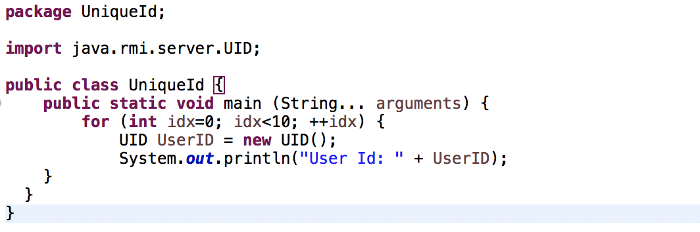
Java Development of Component
Way to display your message inside of a string.
It set an integer from 0 to 10 & out puts a unique student Id
Public Class name: Unique Id
Basically the program labels the intersection of where your input the asks for input and assigns it to the two variables below and it auto generates the a unique Student Id for each you input and assign the program.

Slide 3
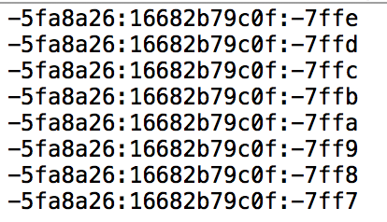
Verbal Description of component
The components basically ask for an x and y coordinate and it basically returns it back with a Student key. Also after one second the program generate multiple student IDs, to check if the Unique Student ID is not generate the same again.
It can be used to generate a unique ID with respect to the host that it was generated on.

Slide 4
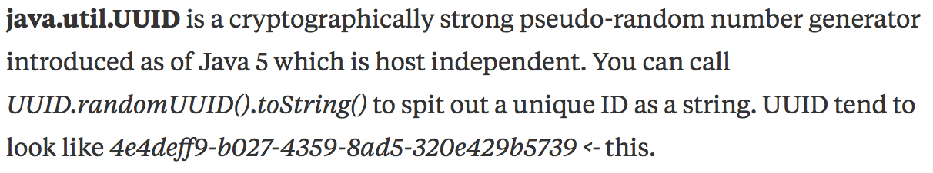
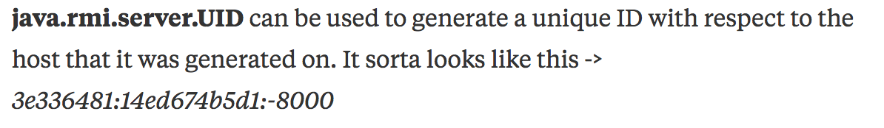
UUID or UID

Slide 5
Integration Requirement & Expectations
Use to print out the message you put in the system
My program is extending to Antoino’s only when he done his part.

